Slide 1
REGISTERS
9
LEACH, MALVINO & SAHA

Slide 2
Registers
A register is simply a group of flip-flops that can be used to store a binary number.
The flip-flops must be connected such that the binary number can be entered ( shifted) into the register and possibly shifted out.
A group of flip-flops connected to provide either or both of these functions is called a shift register (generally used for serial-in / serial –out / both).
There are two ways to shift data into a register (serial or parallel) and similarly two ways to shift the data out of the register.

Slide 3
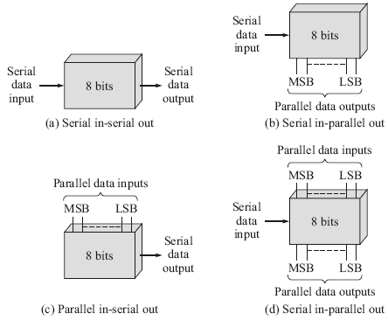
Shift register types

Slide 4
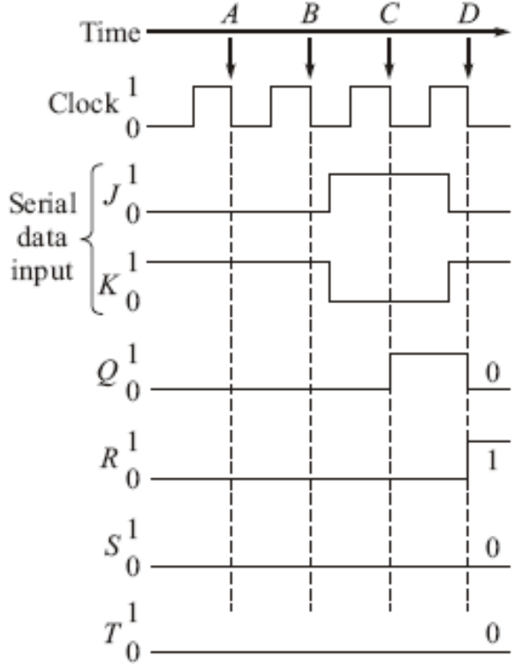
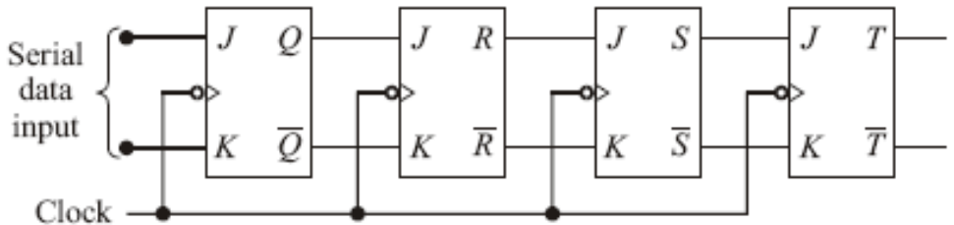
Serial IN-Serial OUT –using JK Flip flop
The flip-flops used to construct registers are usually edge-triggered JK, SR or D types
4-bit serial input shift register.
To shift a 0 into the flip-flop, J=0 and K=1
To shift a 1 into the flip-flop, J=1 and K=0

Slide 5
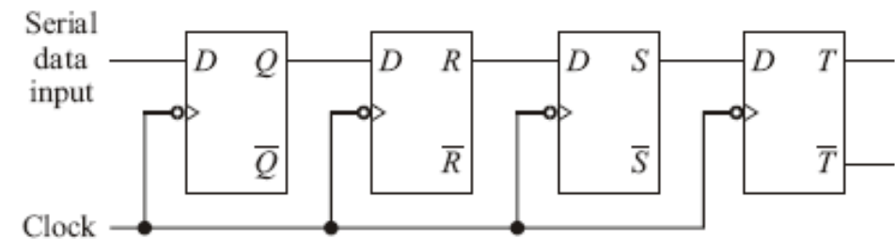
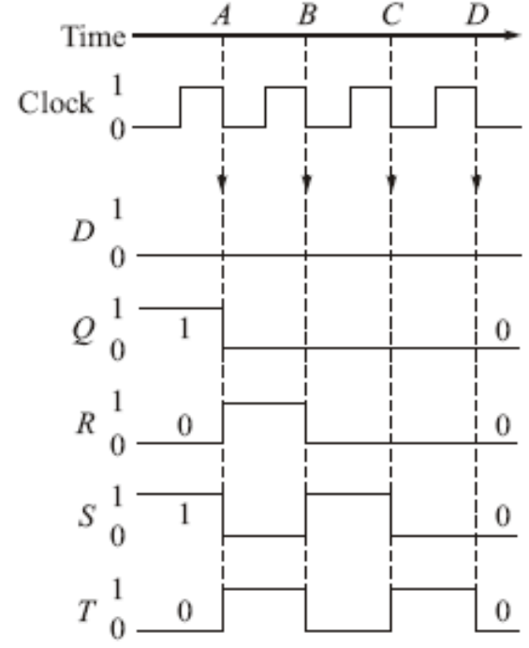
Serial IN-Serial OUT- using D-Flip Flop
Before Time A, The register stores the number QRST=1010
At clock edge A, When clock triggers, these inputs get transferred to corresponding flip-flop outputs simultaneously so that QRST=0101. Thus at clock trigger, values are transferred.
At clock edge B, So after NT at B, QRST=0010.
At cock edge C, QRST=0001.
At clock edge D, QRST=0000

Slide 6
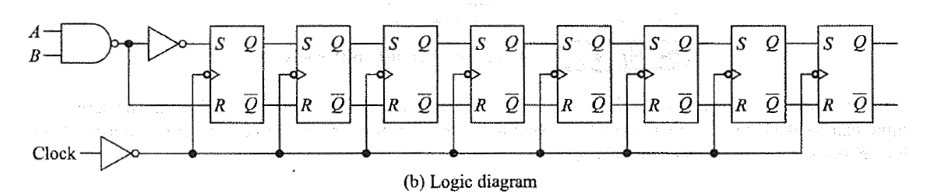
S-R SISO

Slide 7
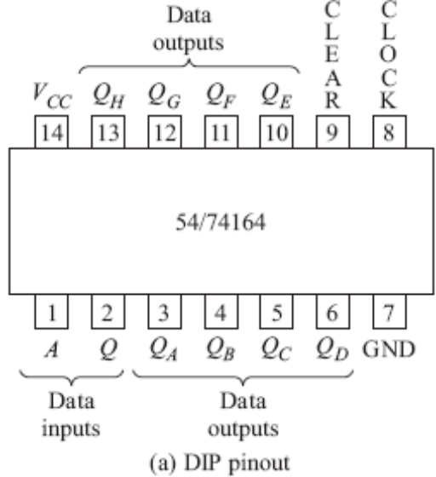
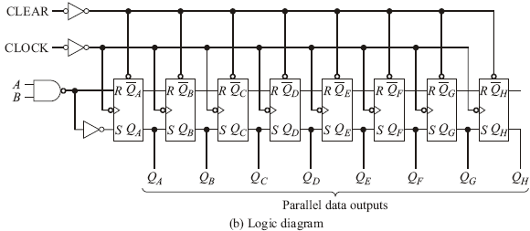
Serial IN-Parallel OUT
Data is shifted in serially, but shifted out in parallel.
A typical response of a 54/74164

Slide 8
Working of 74164 – B is High
B is Held High The NAND gate is enabled and the serial input data passes through the NAND gate inverted. The input data is shifted serially into the register.

Slide 9
B is Held Low
The NAND-gate output is forced high, the input data stream is inhibited, and the next positive clock transition will shift a O into the first flip-flop.
Each succeeding positive clock transition will shift another O into the register. After eight clock pulses, the register will be full of zeros!

Slide 10
Understanding the waveform
The clock begins at time B, but the first PT does nothing since the control line is low. At time C the control line goes high, and the first data bit (a 0) is shifted into the register at time D.
The next 7 data bits are shifted in, in order, at times E, F, G, H, I, J and K. The clock remains high after time K, and the 8-bit number 0010 1100 now resides in the register and is available on the eight output lines.

Slide 11
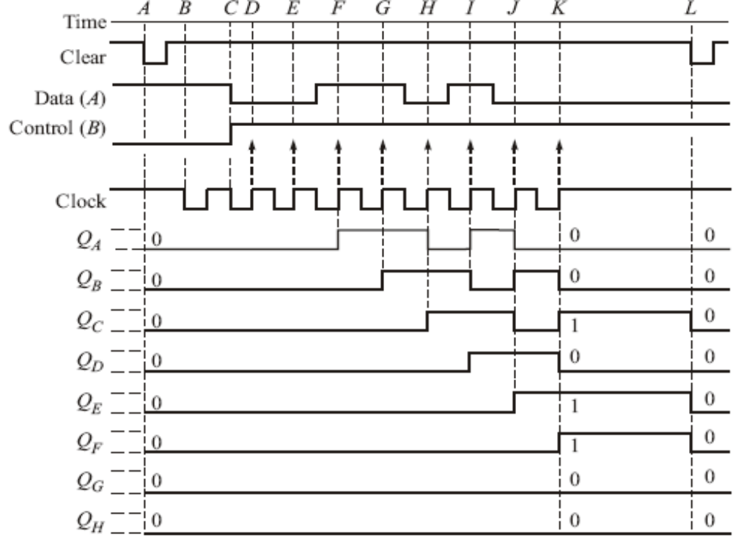
Waveform

Slide 12
Problem
How long will it take to shift an 8-bit number into a 54164 shift register if the clock is set at 1O MHz?
Solution: A minimum of eight clock periods will be required since the data is entered serially. One clock period is 100 ns, so it will require 800 ns minimum.

Slide 13
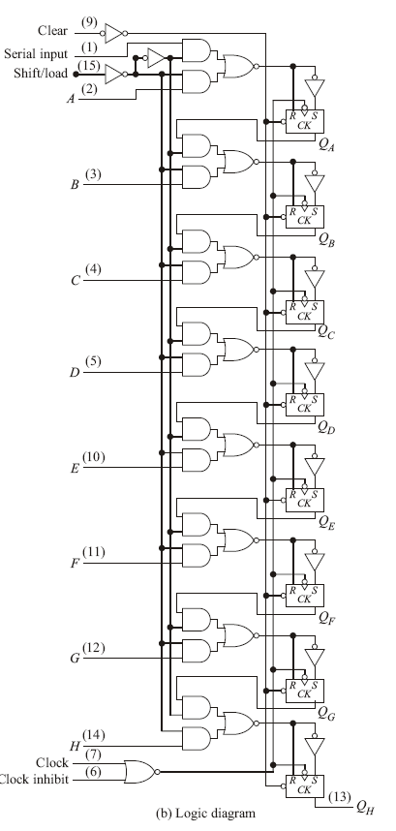
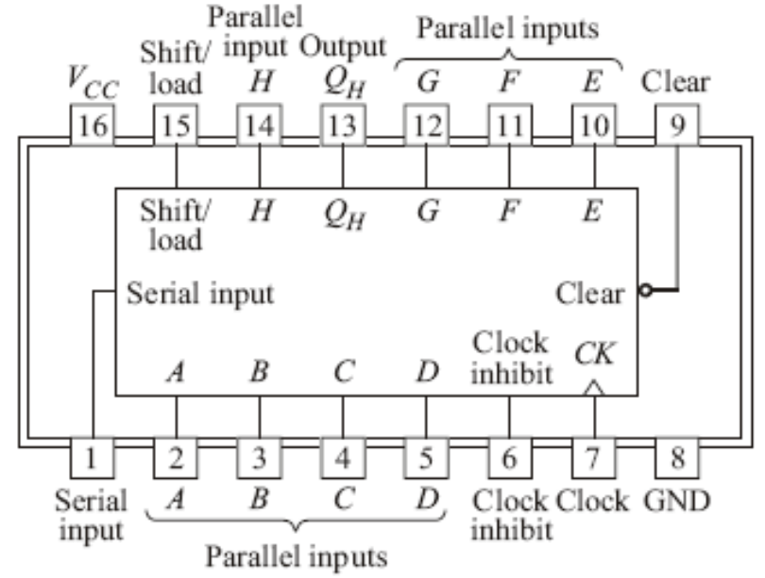
Parallel IN-Serial OUT

Slide 14
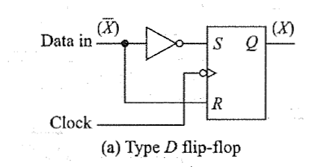
Working
First recognize that the clocked RS flip-flop and the attached inverter given in form a type D flip-flop.

Slide 15
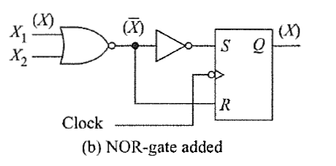
If one leg of this NOR gate is at ground level, a data bit X at the other leg is simply inverted by the NOR gate. For instance, if X = 1, then at the output of the NOR gate X = 0, allowing a 1 to be clocked into the flip-flop.
This NOR gate offers the option of entering data from two different sources, either X1 or X2.

Slide 16
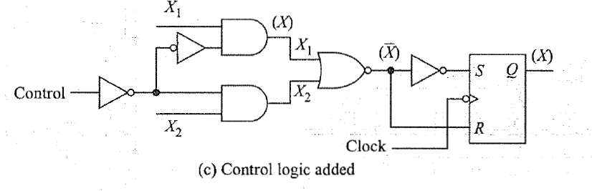
The addition of two AND gates and two inverters will allow the selection of data X1 or dataX2.
If the control line is high, the upper AND gate is enabled and the lower AND gate is disabled.

Slide 17
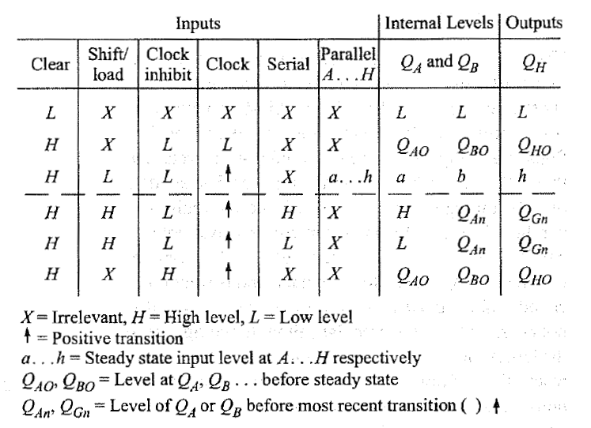
Truth Table for PISO

Slide 18
End of Class

Slide 19
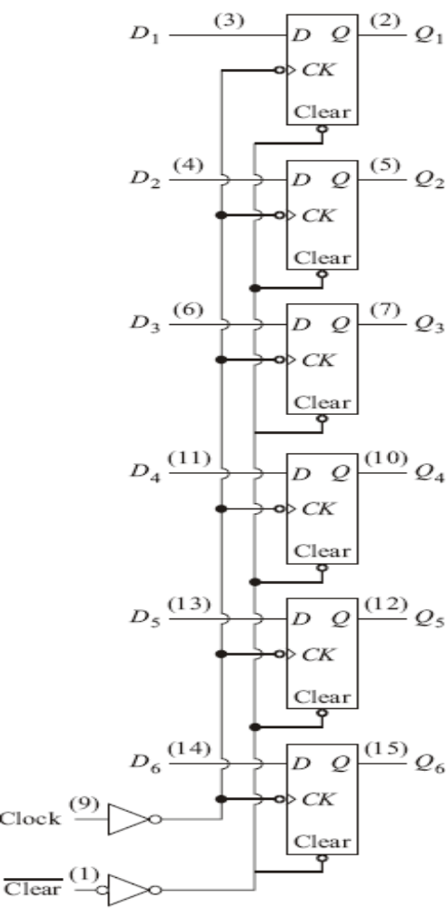
Parallel IN-Parallel OUT

Slide 20
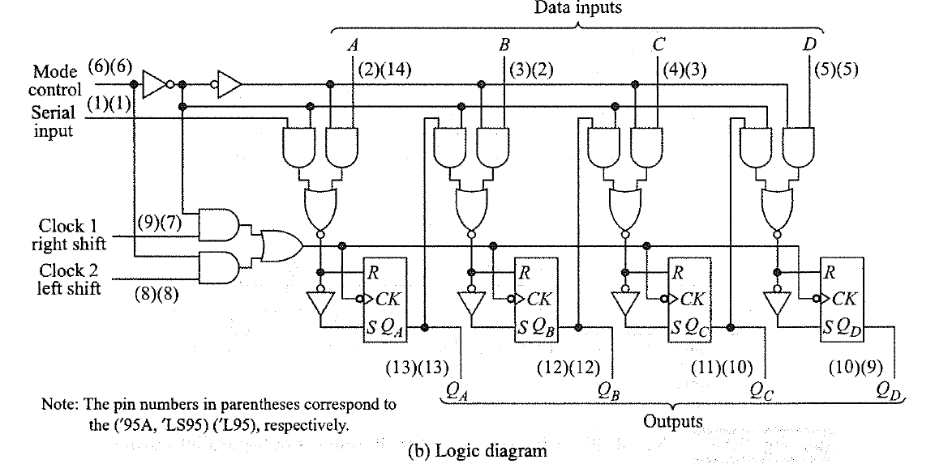
PIPO Logic Diagram

Slide 21
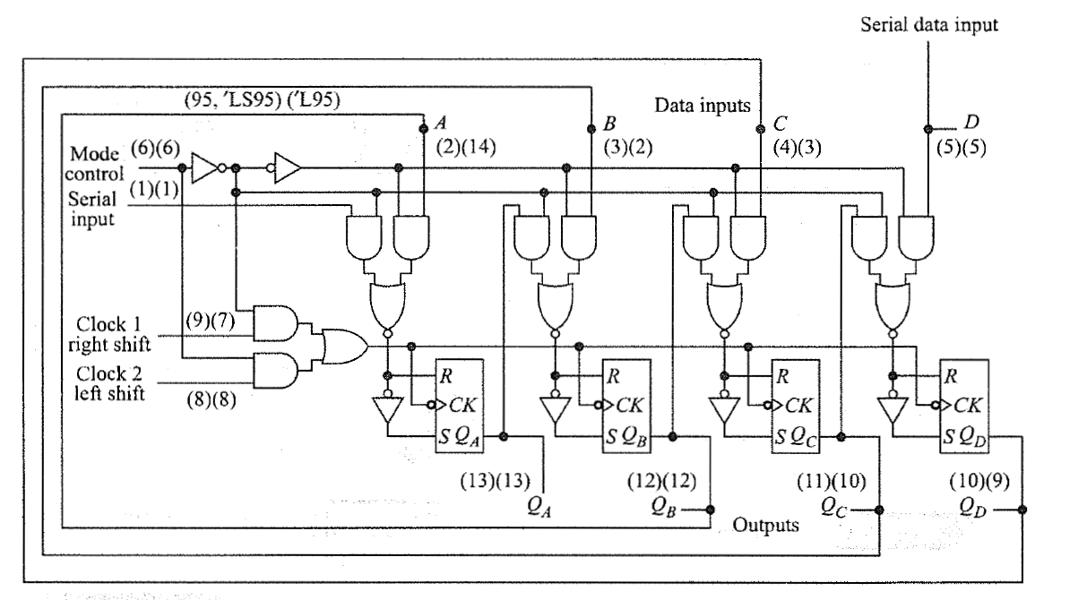
7459A Wired for left shift

Slide 22
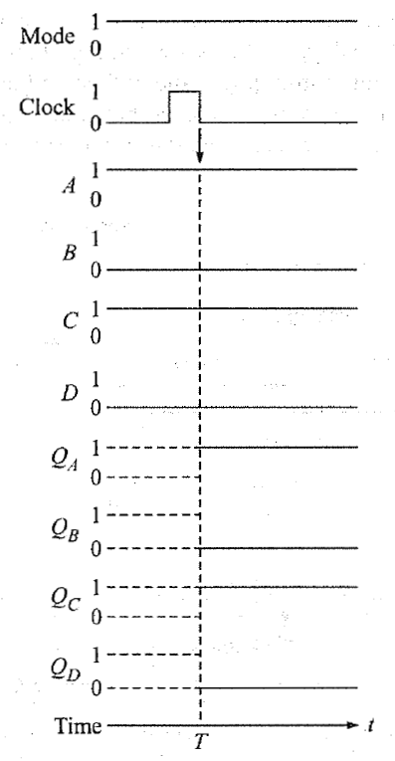
Waveform

Slide 23
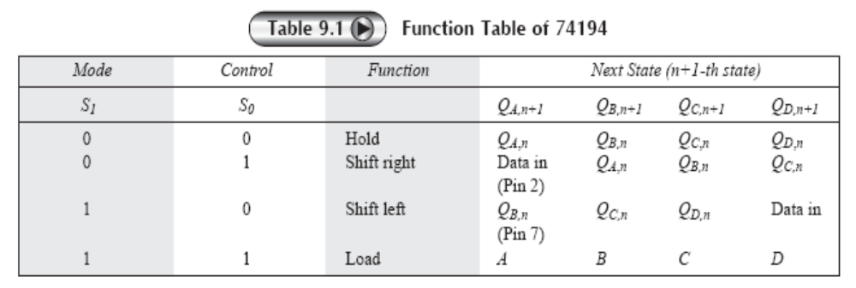
UNIVERSAL SHIFT REGISTER
A universal shift register can perform all the four operations and is also bidirectional in nature

Slide 24
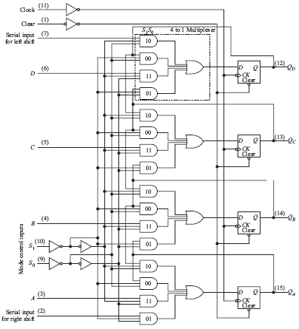
UNIVERSAL SHIFT REGISTER IC 74194

Slide 25
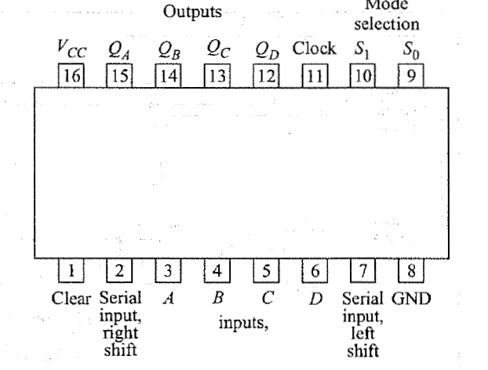
Pinout diagram 74194

Slide 26
End of Class

Slide 27
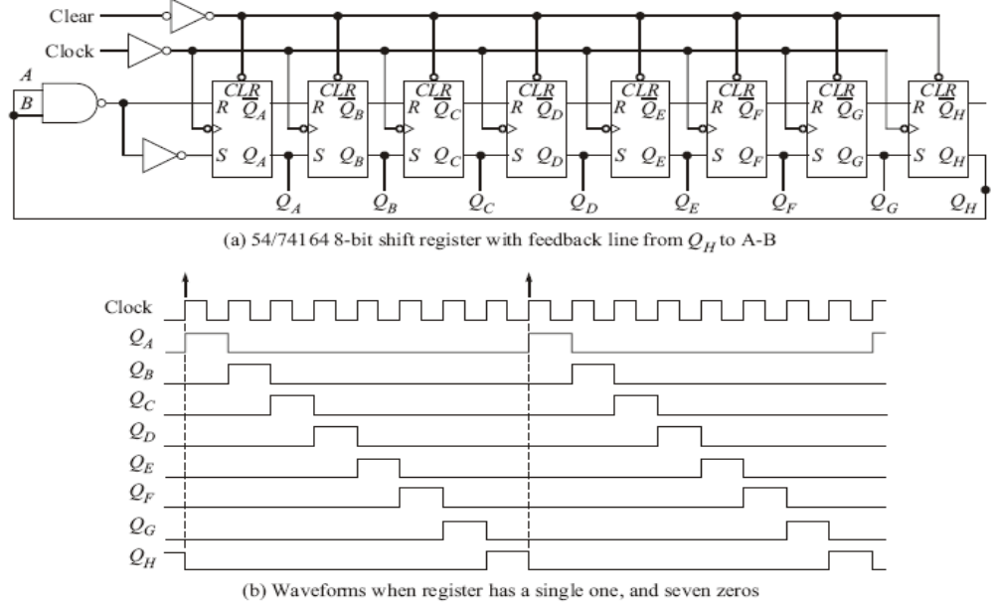
Applications of shift registers
Ring Counters

Slide 28
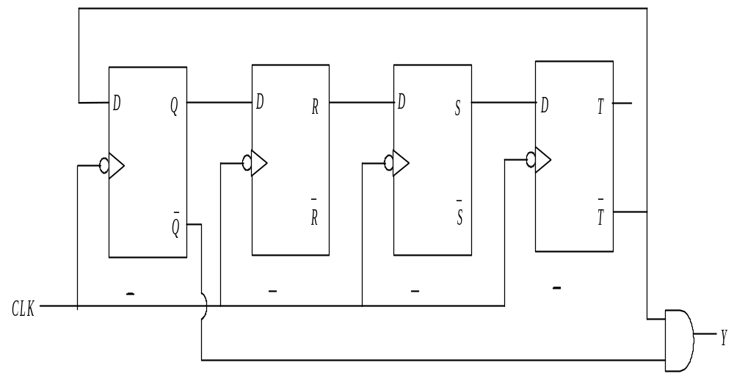
Applications of shift registers
Switched tail counter, also known as twisted tail counter or Johnson counter.
Clock | Serial in = T′ | Q R S T | Y = Q′T′
0 | 1 | 0 0 0 0 | 1
1 | 1 | 1 0 0 0 | 0
2 | 1 | 1 1 0 0 | 0
3 | 1 | 1 1 1 0 | 0
4 | 0 | 1 1 1 1 | 0
5 | 0 | 0 1 1 1 | 0
6 | 0 | 0 0 1 1 | 0
7 | 0 | 0 0 0 1 | 0
8 | 1 | 0 0 0 0 | 1
9 | 1 | 1 0 0 0 | 0 repeats
4-bit switched tail counter and its state table

Slide 29
End of class

Slide 30
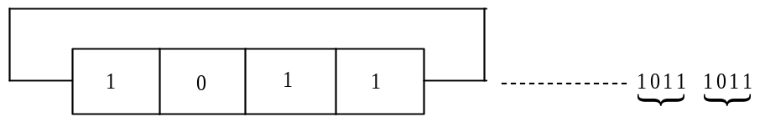
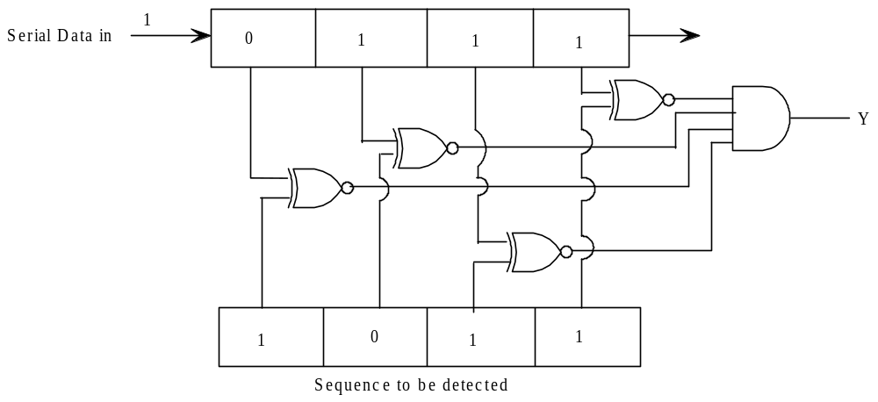
Applications of shift registers
SEQUENCE GENERATOR AND SEQUENCE DETECTOR

Slide 31
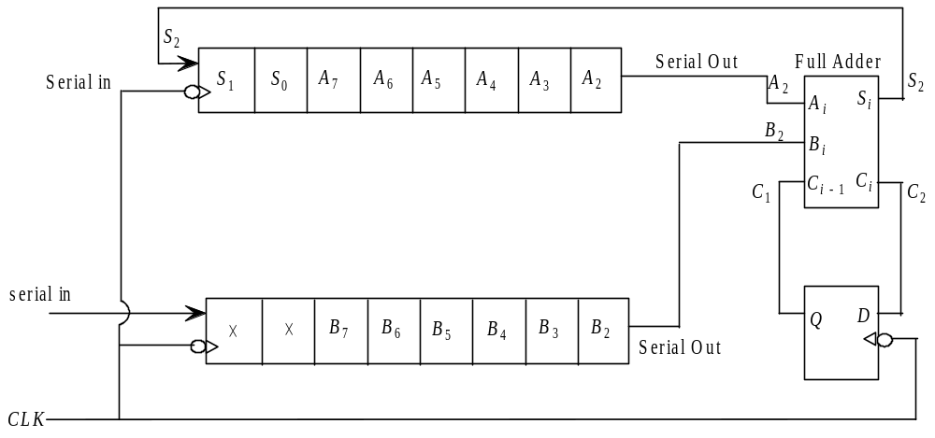
Applications of shift registers
SERIAL ADDER
Serial addition of two 8-bit numbers (Register values shown are at 3rd clock cycle)

Slide 32
End of Chapter 9 - Register

